Slide 1
Reference Guide: Carleton-Willard Village & OnePoint
November 2025

Slide 2
OnePoint
Market
Carleton - Willard
Development
Presentations
Finance
Ctrl+click on any white box with blue border to jump to a slide / category

Slide 3

OnePoint
Site Visit & Visioning
Site Evaluation (Core Objectives & Vulnerabilities)
Site Test Fit
Initial Programs & Pricing for Testing
Financial Feasibility
Capital Strategy
Execution Roadmap
Initial Market Findings
Team:
Mike & Sarah: Partner Sponsors
Kris: Client Lead
Hayley: Engagement Manager
Nicole: Market Expert
Engagement:
Informing Engagement: July 2025
Phase 2 A – Visioning + Positioning/Opportunities Analysis Update
Phase 2 B – Site test Fit + Concept/Offering Development + Future State Financial Modeling + Capital Strategy + Execution Roadmap
Time: 3-4 Months
Fee: $90,0000

Slide 4
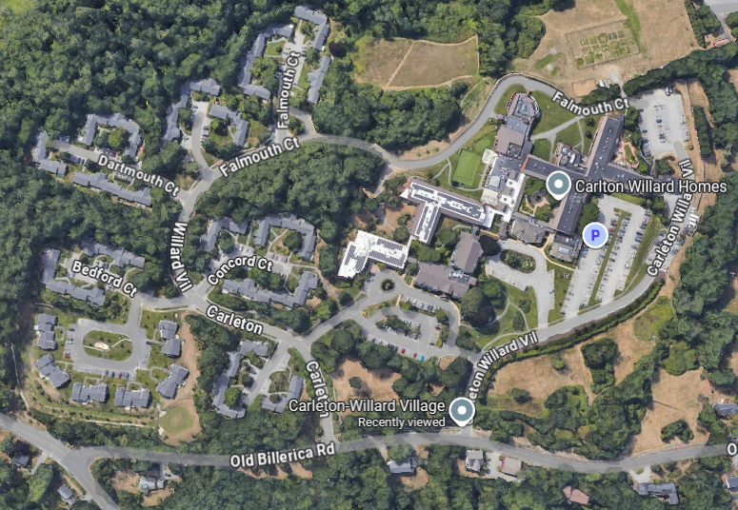
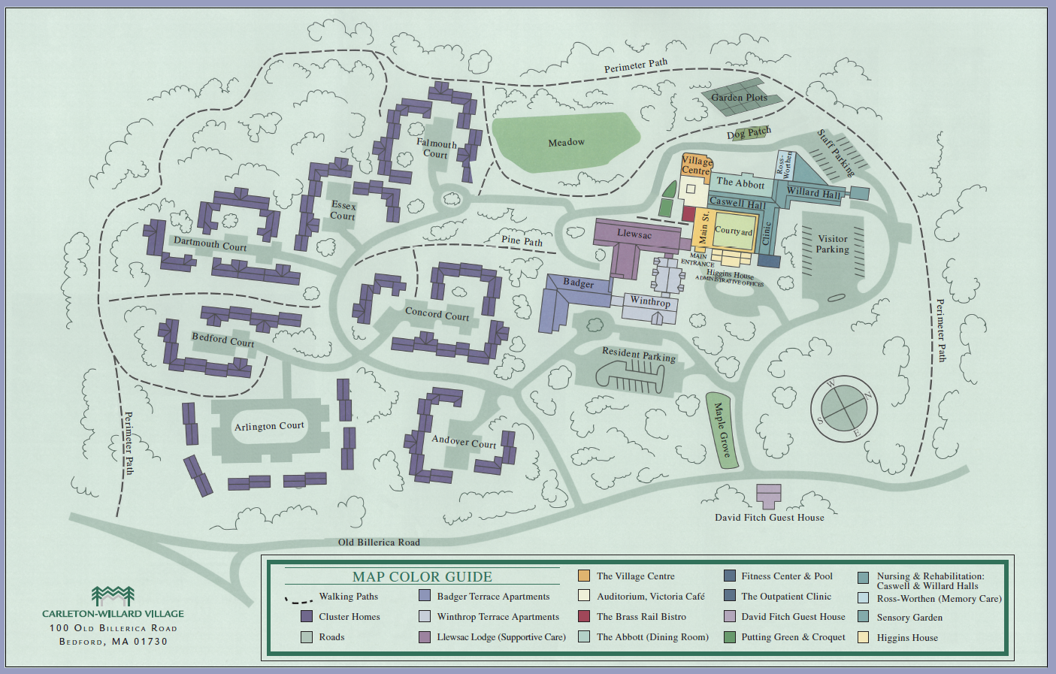
Carleton-Willard
Chris Golen, CEO cgolen@cwvillage.org
Michael Mathews, CFO mmathews@cwvillage.org
https://www.cwvillage.org/
100 Old Billerica Rd, Bedford, MA 01730
Goals:
Maintain and advance CWV’s identity and connection to the outdoors
Enhance indoor and outdoor amenity spaces
Expand Independent Living offerings
Remodel or rebuild current residences (Llewsac)
Reenvision Skilled Nursing building
Reimagine dining, social, or recreational spaces

Slide 5
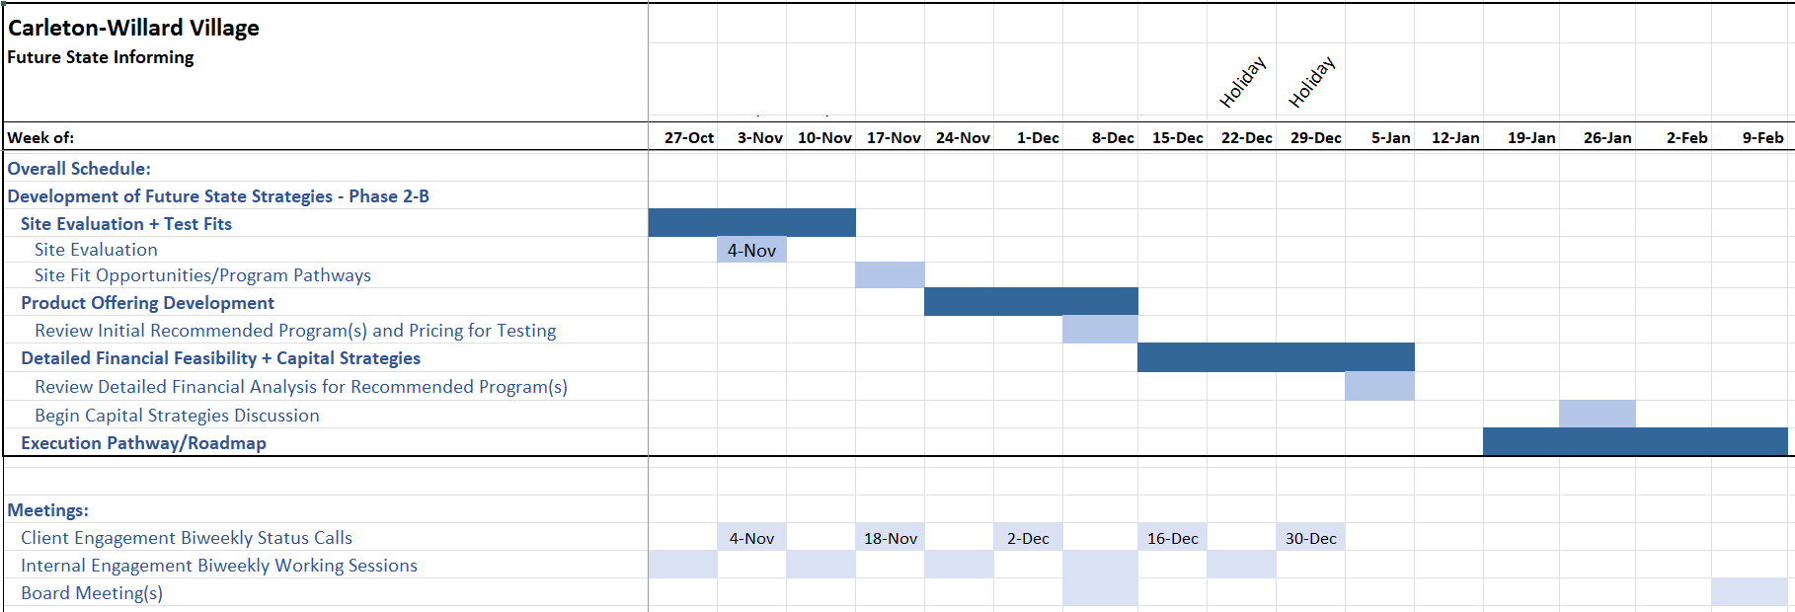
Schedule

Slide 6
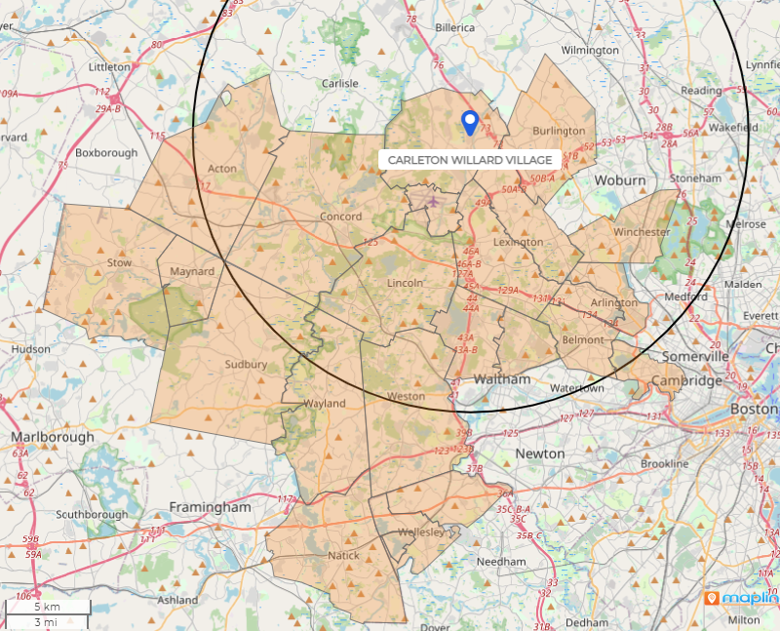
Market
Responsibilities:
Create PMA
Evaluate and analyze market potential
Initial Programs & Pricing
Initial Market Findings
Sept 9, 2025

Slide 7
Market

Slide 8
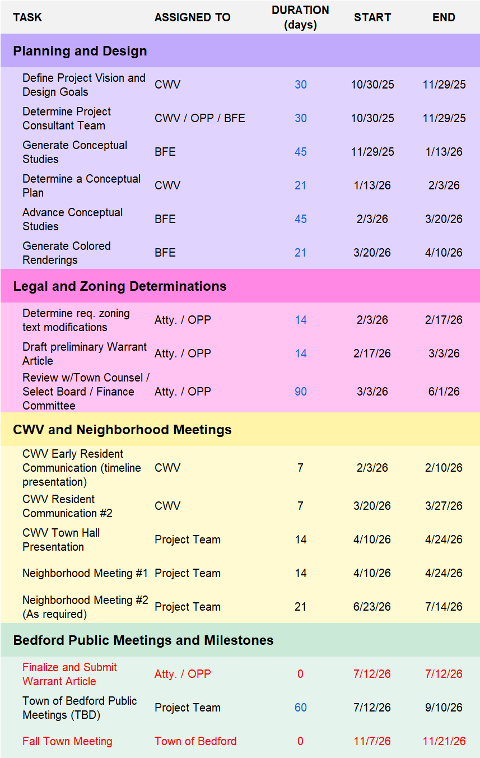
Development
Responsibilities:
Site Test Fit
Organize Project Team
Architect RFQ
Architect Selection
Land Use
Other?
Initial Budget
Rebalancing the amount of IL on campus vs. Healthcare
Addressing key campus vulnerabilities:
Aging skilled nursing building
Large number of nursing beds
Aging Llewsac building & product that is very expensive for how it is currently positioned
No assisted living-level memory care
Addressing changing expectations of new consumers:
Desire for larger/more contemporary residences
Demand for specialized dementia care in a non-skilled/institutional setting
Taking advantage of market opportunities:
Market demand in both IL and AL-level Dementia Care
Site Opportunities Discussion
Nov 6, 2025

Slide 9
Finance
Responsibilities:
Financial feasibility
Capital Strategy

Slide 10
Presentations
Initial Market Findings
Sept 9, 2025
Engagement Reset
Oct 31, 2025
Site Opportunities Discussion
Nov 6, 2025

Slide 11
Carleton Willard Village Initial Market Findings
September 9, 2025

Slide 12

Agenda
1
MARKET AREA SUMMARY
2
DEMAND ANALYSIS
3
APPENDIX

Slide 13
Market Area Summary

Slide 14
Primary Market Area
The primary market area (“PMA”) was defined as a 23-zip code area surrounding CWV representing 67% of current residents.

Slide 15
Demographics – Primary Market Area
*Demographic data via ESRI

Slide 16
Demand Analysis

Slide 17
Independent Living Demand
The Market Penetration Rate falls well within typically targeted range (less than approximately 25%)
The Project Capture Rate for the campus also falls well under typically targeted range (approx. 3% - 5%) and decreases in the future year.

Slide 18
Independent Living Demand (Continued)
Assuming a (conservative) 2.0% capture rate and current in-migration of 32.8%, the total number of supportable units on the CWV campus is approximately 318 in the current year and approximately 445 in the future year.
This is an addition of 164 units in the current year.
Total number of supportable units includes the 154 existing units at CWV

Slide 19
Assisted Living Demand
The Market Penetration Rate for Assisted Living falls within the typically targeted range (less than approximately 50%)
The Project Capture Rate for the existing rest home beds falls well under typically targeted range (approx. 15%).
These metrics indicate a market that is mature and developed with existing supply, but that can support the existing beds at CWV.

Slide 20
Alzheimer’s Dementia Care Demand (AL-level)
The Market Penetration Rate for Alzhiemer’s Dementia Care falls within the typically targeted range (approximately 35%)
Supportable beds analysis indicates a market that can support additional AL-level Dementia Care product.

Slide 21
Demand Takeaways
The Carleton Willard Market Area has strong support for additional product in both Independent Living and Dementia Care
This is not a surprise, it is rather a confirmation of what we suspected.
The market will not pose a limitation for additional Independent Living product on the CWV campus. Rather, it will be more of an exercise to determine just what the campus can and should look like in future build-out.
Assisted Living as a dedicated product is fairly built out in the CWV market area. This care level is currently provided within the rest home units on campus and can also be provided as needed through care delivery to an IL unit.
While it does not appear management is currently interested in adding assisted living-level Dementia Care to the campus, there is market support for this product should that viewpoint shift in the future.

Slide 22
Appendix

Slide 23
Market Area Demographics
*Demographic data via ESRI
Above average concentration of older adults in 2025, and is expected to increase
(National average 2024: 65+: 18.1%; 75+: 7.7%)

Slide 24
Market Area Demographics
*Demographic data via ESRI
Target market of 11,600 households in 2025, and nearly 16,000 in 2030 ($75K income level).

Slide 25
Market Area Demographics
*Demographic data via ESRI
PMA home values are high. Important metrics to consider when determining monthly fees and entrance fees.

Slide 26
Market Area Demographics
*Demographic data via ESRI
*Demographic data via ESRI
PMA HH Income and net worth are high. Important metrics to consider when determining monthly fees and entrance fees.

Slide 27
Carleton-Willard Village & OnePoint
October 31, 2025

Slide 28
Agenda:
Status Update – Phase 2
Future Site Core Objectives
Looking Ahead

Slide 29
Status Update – Phase 2
Site Visit & Visioning
Site Evaluation (Core Objectives & Vulnerabilities)
Site Test Fit
Initial Programs & Pricing for Testing
Financial Feasibility
Capital Strategy
Execution Roadmap
Initial Market Findings

Slide 30
Future Site Core Objectives
Rebalancing the amount of IL on campus vs. Healthcare
Addressing key campus vulnerabilities:
Aging skilled nursing building
Large number of nursing beds
Aging Llewsac building & product that is very expensive for how it is currently positioned
No assisted living-level memory care
Addressing changing expectations of new consumers:
Desire for larger/more contemporary residences
Demand for specialized dementia care in a non-skilled/institutional setting
Taking advantage of market opportunities:
Market demand in both IL and AL-level Dementia Care

Slide 31
Looking Ahead

Slide 32
Pathway to Fall 2026 Town Meeting

Slide 33
Carleton-Willard Village & OnePoint
November 6, 2025

Slide 34
Agenda:
Site Overview
Envisioning the Future of Carleton-Willard Village
Next Steps

Slide 35







Slide 36
Envisioning the Future of Carleton-Willard Village
Maintain and advance CWV’s identity and connection to the outdoors
Remodel or rebuild current residences (Llewsac)
Reenvision Skilled Nursing building
Reimagine dining, social, or recreational spaces
Expand Independent Living offerings
Enhance indoor and outdoor amenity spaces

Slide 37
“Goal Posts”
Independent Living unit expansion
Minimum?
Maximum?
Care level rightsizing
Minimize exposure to Medicaid (but some retained)
Financial metrics
Any “sacred cows”? Elements that are non-negotiable or must be preserved?
Ex. Carleton-Willard Village & its connection to nature

Slide 38
Next Steps
Potential RFQ Process
Level of Cares to Explore
Site Test Fit
Initial Pricing Exercise
Financial Feasibility

